Slide 1
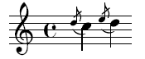
Grace: Safe Multithreaded Programming for C/C++
Emery Berger
University of Massachusetts, UPC/BSC
www.cs.umass.edu/~emery

Slide 3
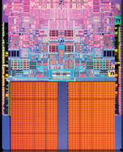

Slide 16


Slide 17


Slide 24

“
”

Slide 30
race condition

Slide 35
atomicity violation

Slide 38
deadlock

Slide 42
order violation

Slide 44
sequential

Slide 45

sequential

Slide 47
race conditions

Slide 48
race conditions
atomicity violations

Slide 49
race conditions
atomicity violations
deadlock

Slide 50
race conditions
atomicity violations
deadlock
order violations

Slide 51


Slide 52
race conditions
atomicity violations
Grace
deadlock
order violations

Slide 53
race conditions
atomicity violations
Grace
deadlock
order violations

Slide 54
race conditions
atomicity violations
Grace
deadlock
order violations
sequential

Slide 55
Grace
% g++ myprog.cpp –lpthread –o myprog

Slide 56
Grace
% g++ myprog.cpp –lgrace –o myprog

Slide 57
Grace
% g++ myprog.cpp –lgrace –o myprog
sequential

Slide 58
Grace
% g++ myprog.cpp –lgrace –o myprog
sequential
race conditions
atomicity violations
deadlock
order violations

Slide 59
Grace
% g++ myprog.cpp –lgrace –o myprog
sequential
race conditions
atomicity violations
deadlock
order violations

Slide 60
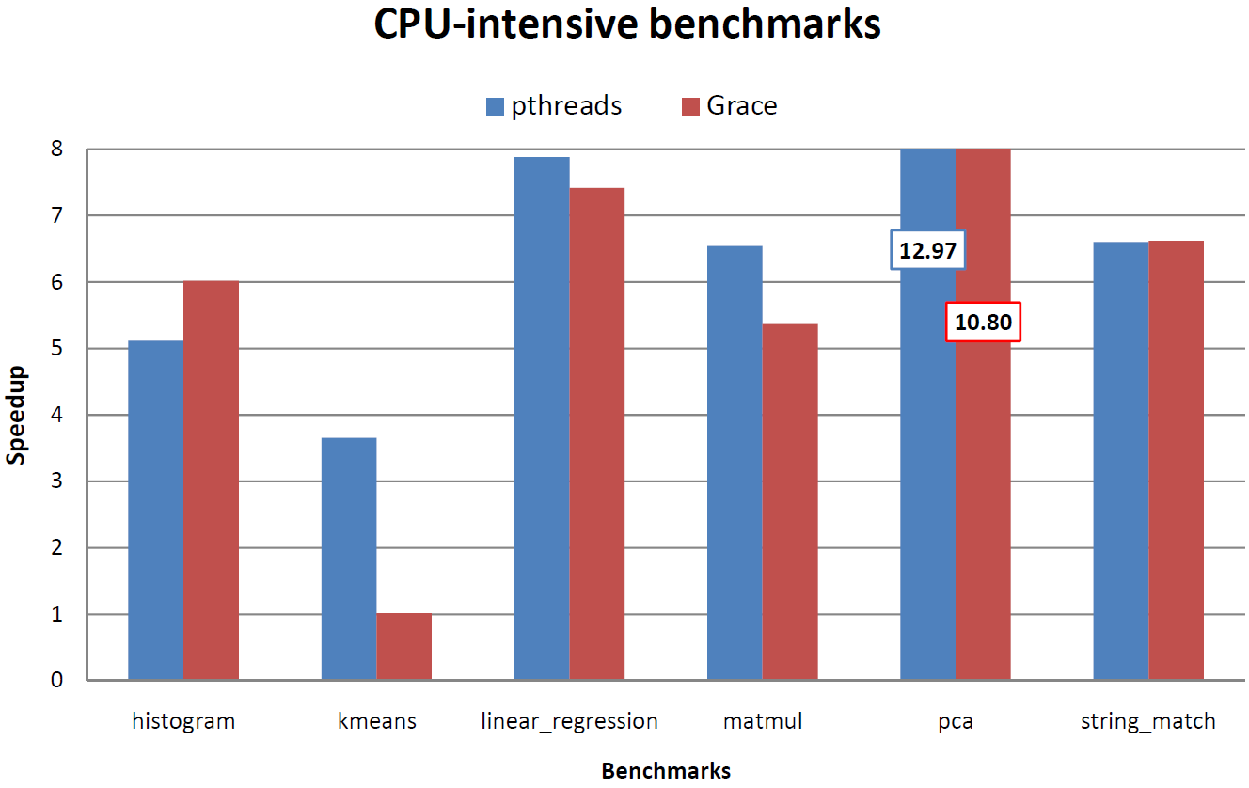


Safe and (usually) fast…

Slide 61

benign race

Slide 62
Grace
1.
sequential
+
?

Slide 63
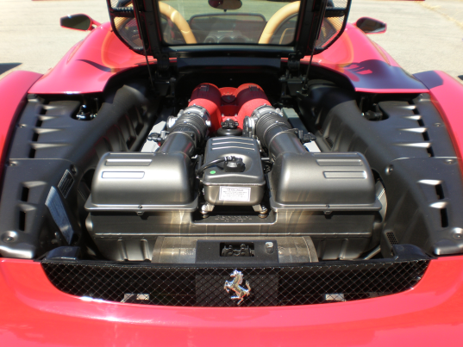
Grace
1.
sequential
+
?
2.

Slide 64

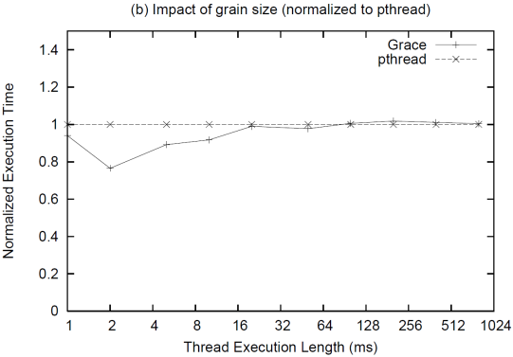
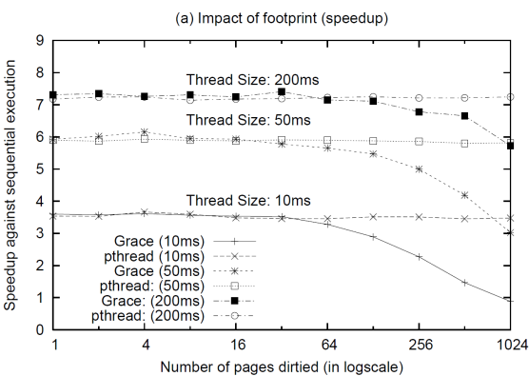
Grace
1.
sequential
+
?
2.
3.

Slide 65
1.
sequential
+
?

Slide 66
1.
sequential
+
?
t1 = spawn f(x);
t2 = spawn g(y);
sync;

Slide 67
1.
sequential
+
?
spawn f(x)
t1 = spawn f(x);
t2 = spawn g(y);
sync;

Slide 68
1.
sequential
+
?
spawn f(x)
t1 = spawn f(x);
t2 = spawn g(y);
sync;
f(x)

Slide 69
1.
sequential
+
?
spawn f(x)
t1 = spawn f(x);
t2 = spawn g(y);
sync;
f(x)
spawn g(y)

Slide 70
1.
sequential
+
?
spawn f(x)
t1 = spawn f(x);
t2 = spawn g(y);
sync;
f(x)
spawn g(y)
g(y)

Slide 71
1.
sequential
+
?
spawn f(x)
t1 = spawn f(x);
t2 = spawn g(y);
sync;
f(x)
spawn g(y)
g(y)
sync

Slide 72
1.
sequential
+
?
spawn f(x)
t1 = spawn f(x);
t2 = spawn g(y);
sync;
f(x)
spawn g(y)
g(y)
sync

Slide 73
1.
sequential
+
?
spawn f(x)
t1 = spawn f(x);
t2 = spawn g(y);
sync;
f(x)
spawn g(y)
g(y)
left-to-right, depth-first ordering
sync

Slide 74
1.
sequential
+
?
f(x)
t1 = spawn f(x);
t2 = spawn g(y);
sync;
g(y)

Slide 75
1.
sequential
+
?
“
f(x)
”
t1 = spawn f(x);
t2 = spawn g(y);
sync;
g(y)

Slide 76
1.
sequential
+
?
“
f(x)
”
g(y)

Slide 77
1.
sequential
+
?
“
f(x)
”
race conditions
g(y)
atomicity violations
deadlock
order violations

Slide 78
1.
sequential
+
?
“
f(x)
”
race conditions
g(y)
atomicity violations
deadlock
order violations

Slide 79
1.
sequential
+
?
“
f(x)
”
race conditions
g(y)
atomicity violations
deadlock
order violations

Slide 80

1.
sequential
+
?
“
f(x)
”
race conditions
g(y)
atomicity violations
deadlock
order violations

Slide 81
1.
sequential
+
?
“
f(x)
”
race conditions
g(y)
atomicity violations
deadlock
order violations

Slide 82
1.
sequential
+
?
“
f(x)
”
race conditions
g(y)
atomicity violations
deadlock
order violations

Slide 83
1.
sequential
+
?
“
f(x)
”
race conditions
g(y)
atomicity violations
deadlock
order violations

Slide 84

1.
sequential
+
?
“
f(x)
”
g(y)

Slide 85
1.
sequential
+
?
“
f(x)
”
g(y)

Slide 86

1.
sequential
+
?
“
f(x)
”
g(y)

Slide 87
1.
sequential
+
?
“
f(x)
”
g(y)

Slide 88
1.
sequential
+
?
“
f(x)
”
g(y)

Slide 89

1.
sequential
+
?
“
f(x)
”
g(y)
Fork-join (e.g., map-reduce, Cilk, TBB…)

Slide 90
2.
?
What’s under the hood?

Slide 91

2.
?
“Magic!”

Slide 92

2.
?
+

Slide 93
2.
?

Slide 94

2.
?
t1 = spawn f(x);
t2 = spawn g(y);
sync;

Slide 95

2.
?
t1 = spawn f(x);
t2 = spawn g(y);
sync;
if (!fork())
f(x);
if (!fork())
g(y);
// check;

Slide 96
spawn f(x)
2.
?
f(x)
spawn g(y)
g(y)
sync
if (!fork())
f(x);
if (!fork())
g(y);
// check;

Slide 97

spawn f(x)
2.
?
f(x)
spawn g(y)
g(y)
sync
if (!fork())
f(x);
if (!fork())
g(y);
// check;

Slide 98
spawn f(x)
2.
?
f(x)
spawn g(y)
g(y)
sync
Note: Nested threads ok
if (!fork())
f(x);
if (!fork())
g(y);
// check;

Slide 99
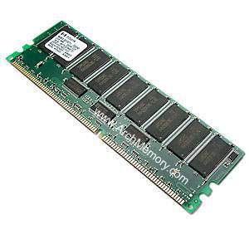
spawn f(x)
2.
?
f(x)
spawn g(y)
g(y)
mmap
sync

Slide 100
spawn f(x)
2.
?
f(x)
spawn g(y)
g(y)
mmap
sync

Slide 101
spawn f(x)
2.
?
f(x)
spawn g(y)
g(y)
mmap
sync

Slide 102
spawn f(x)
2.
?
f(x)
spawn g(y)
g(y)
sync

Slide 103
spawn f(x)
2.
?
f(x)
spawn g(y)
g(y)
sync
1

Slide 104
spawn f(x)
2.
?
f(x)
spawn g(y)
g(y)
sync
1
2

Slide 105


2.
?
scalable heap + aligned globals I/O (buffering + ordering)

Slide 106
3.
More detailed results…

Slide 108
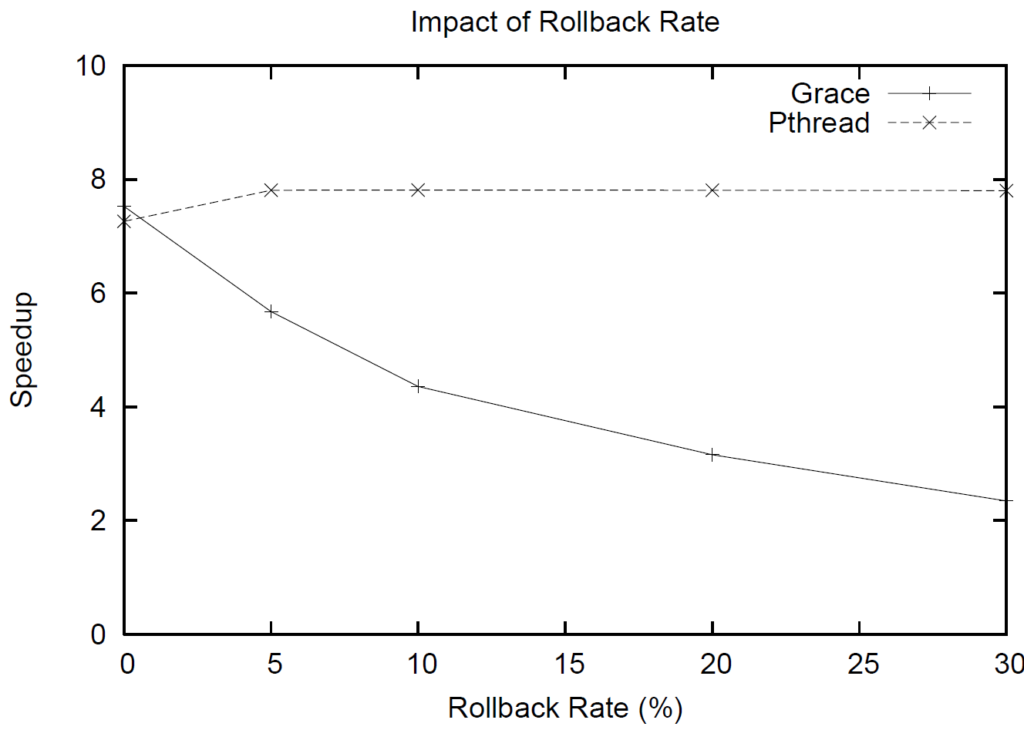

Slide 110
Grace
sequential
race conditions
atomicity violations
deadlock
order violations

Slide 111
Grace
sequential
race conditions
atomicity violations
deadlock
order violations

Slide 112

Grace
sequential
race conditions
atomicity violations
deadlock
order violations

Slide 113
Grace
sequential
race conditions
atomicity violations
deadlock
order violations
% g++ myprog.cpp –lgrace –o myprog

Slide 114


“Moltes gràcies”

Slide 115
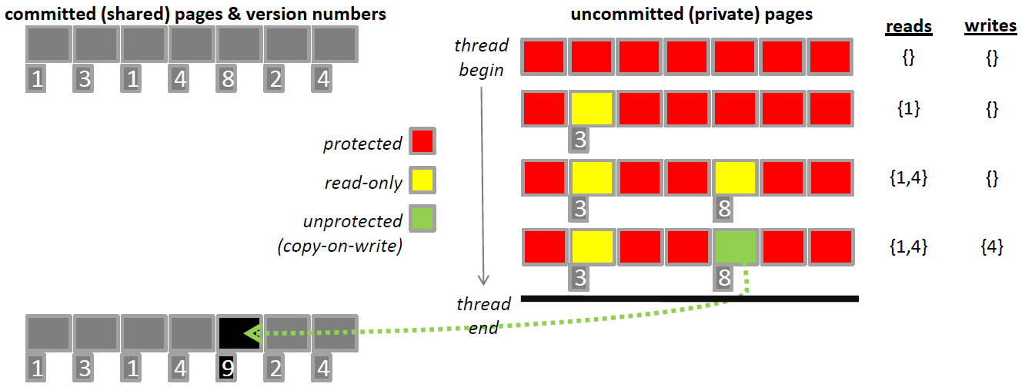
2.
?

Slide 116
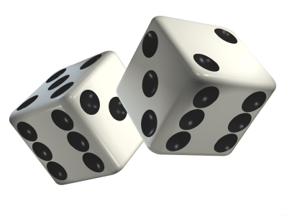
2.
?

Slide 117
2.
?
+

Slide 118
2.
?
+
+

